Slide 1
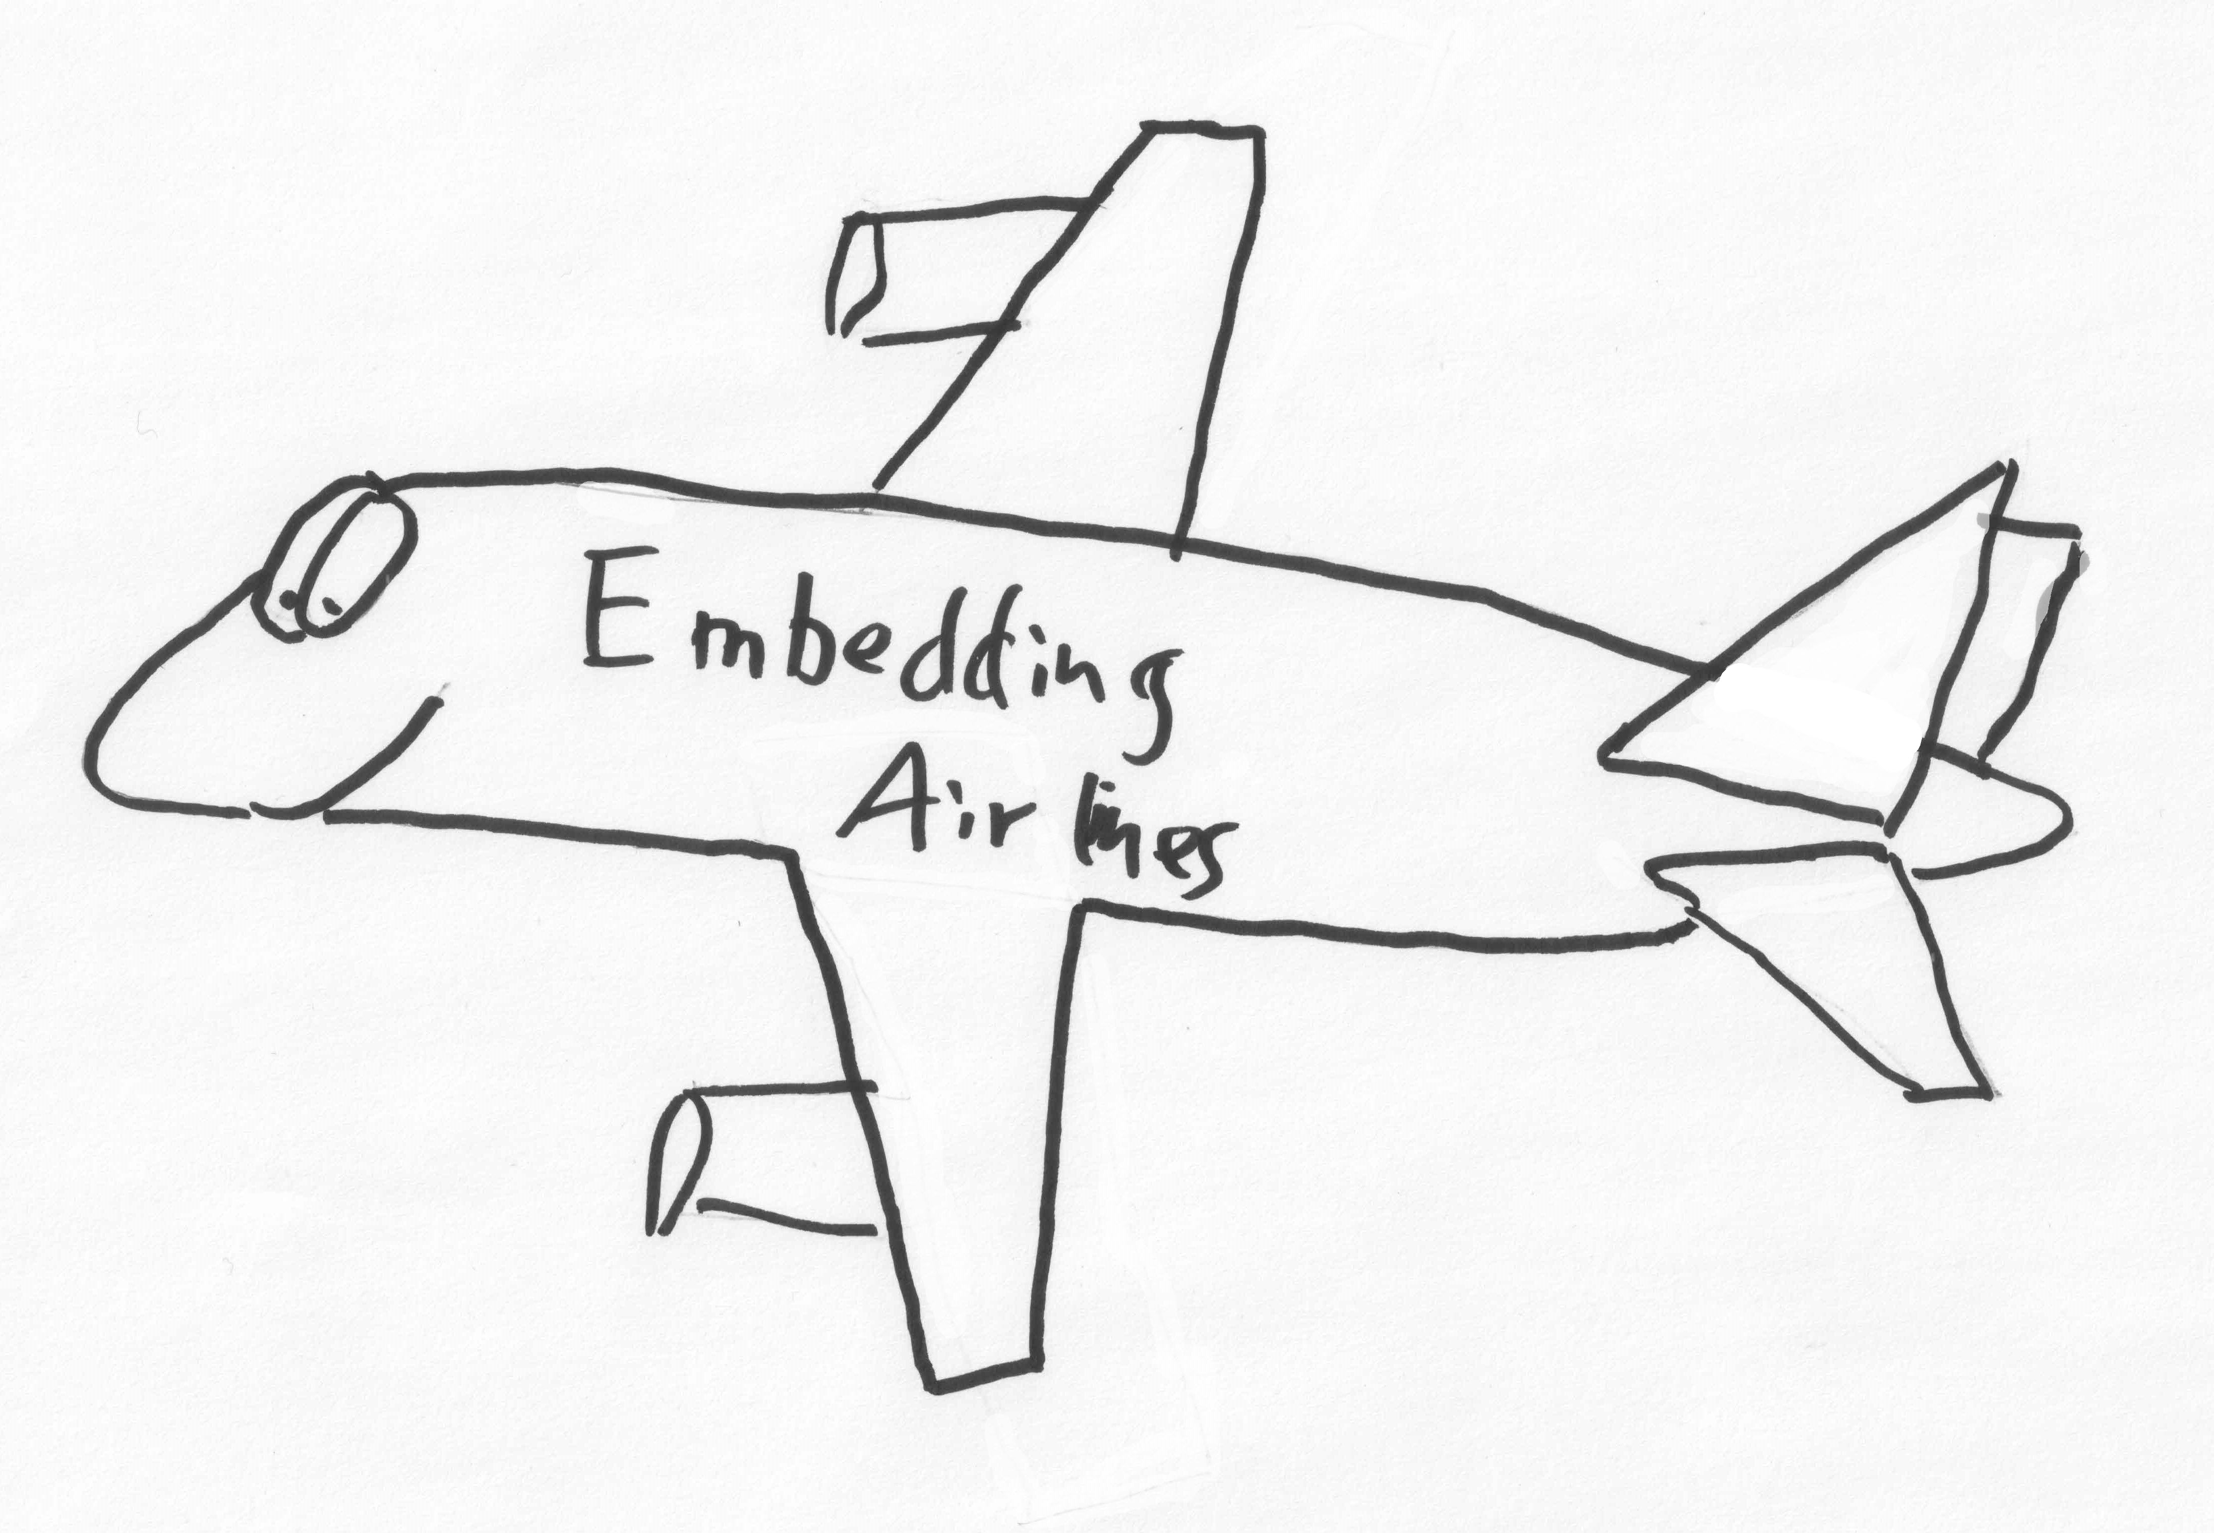
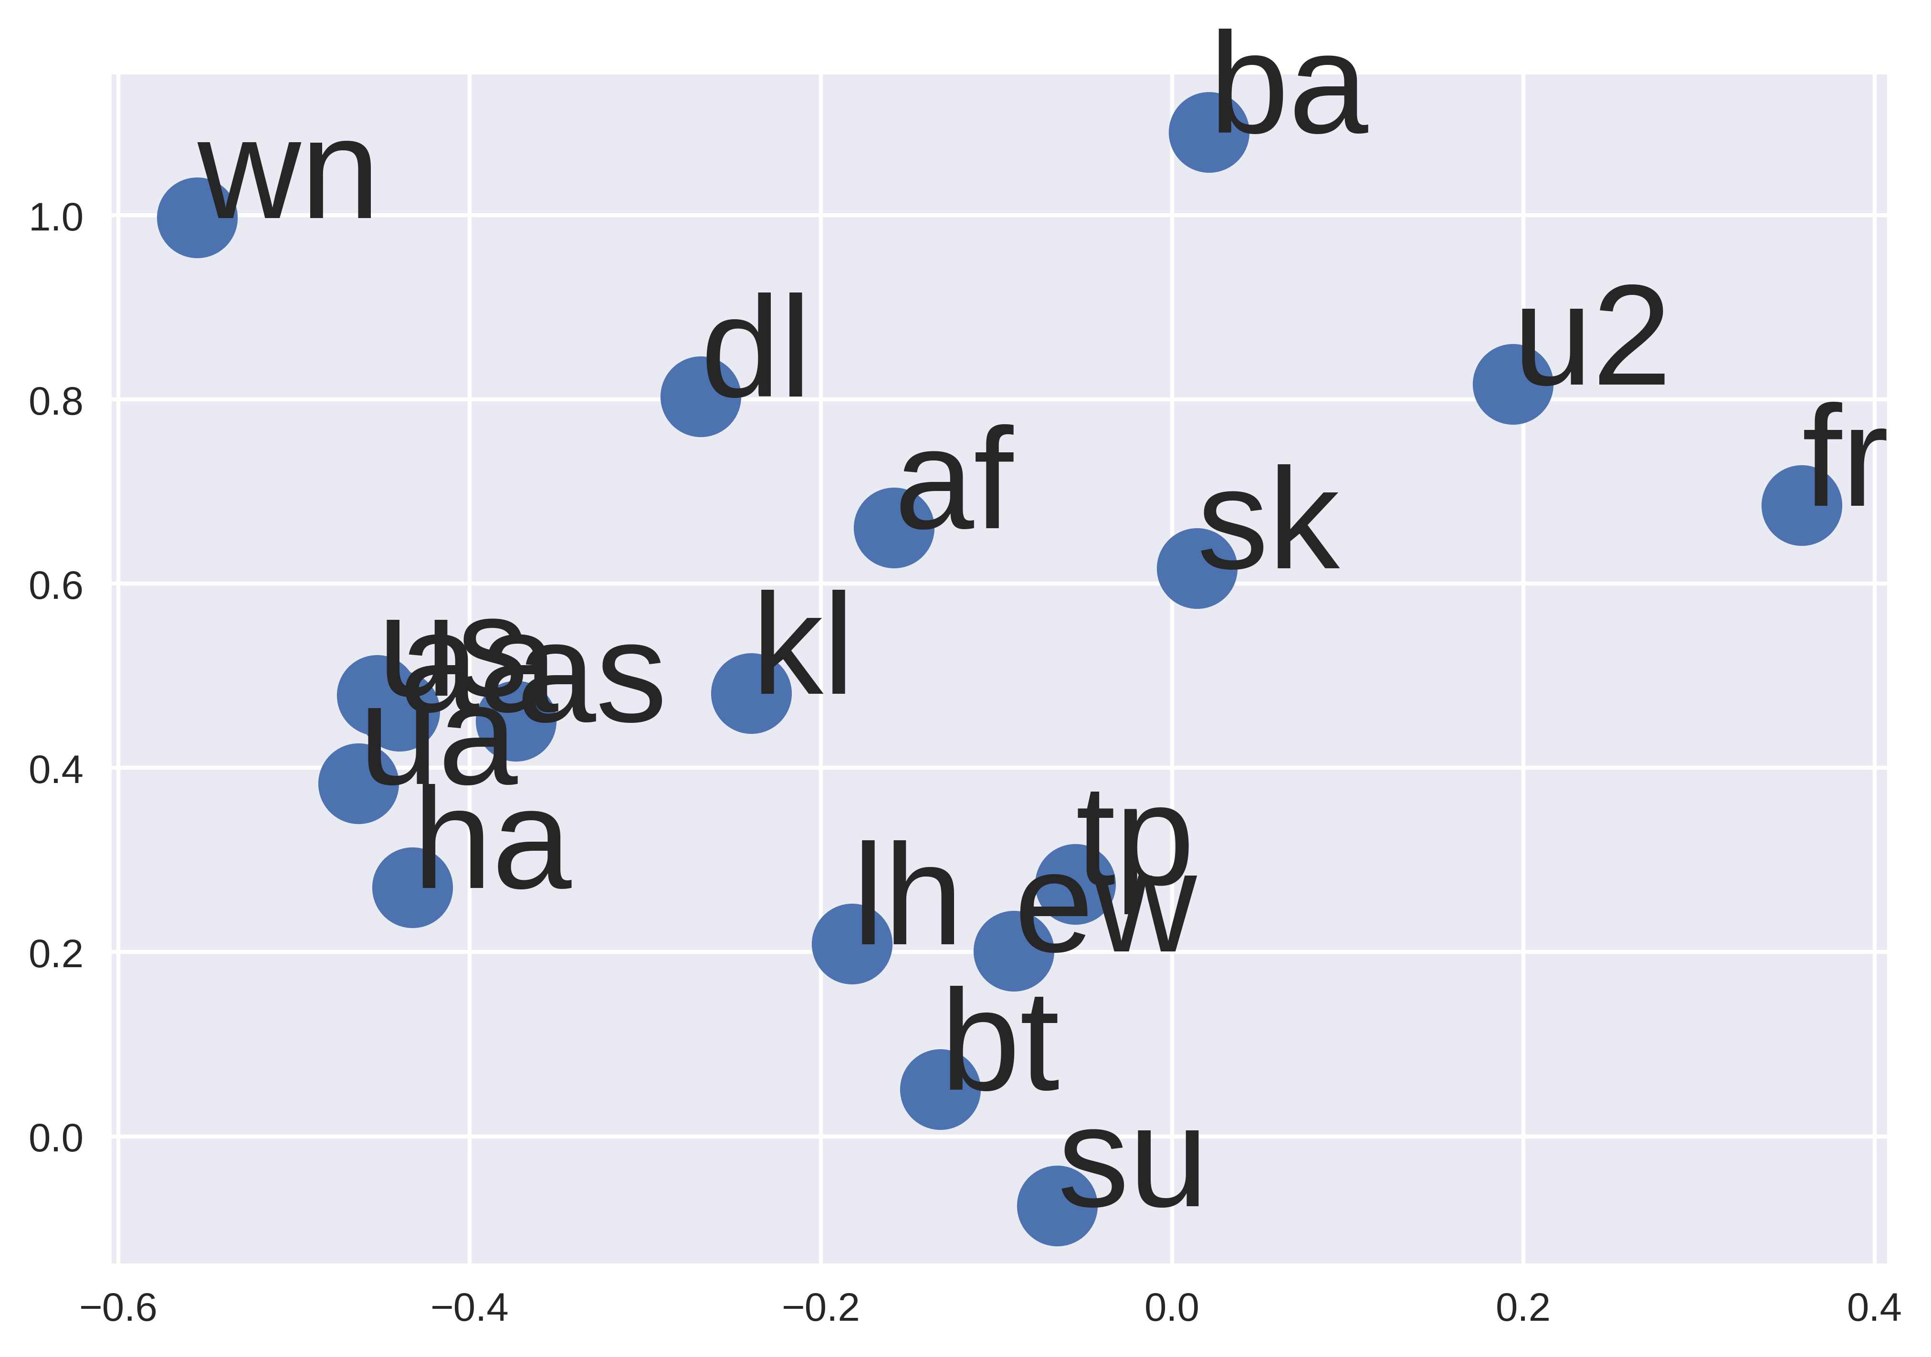
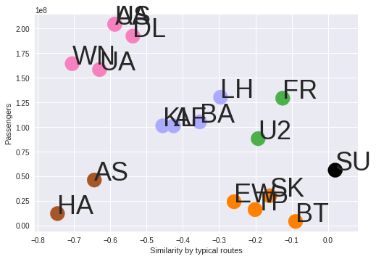
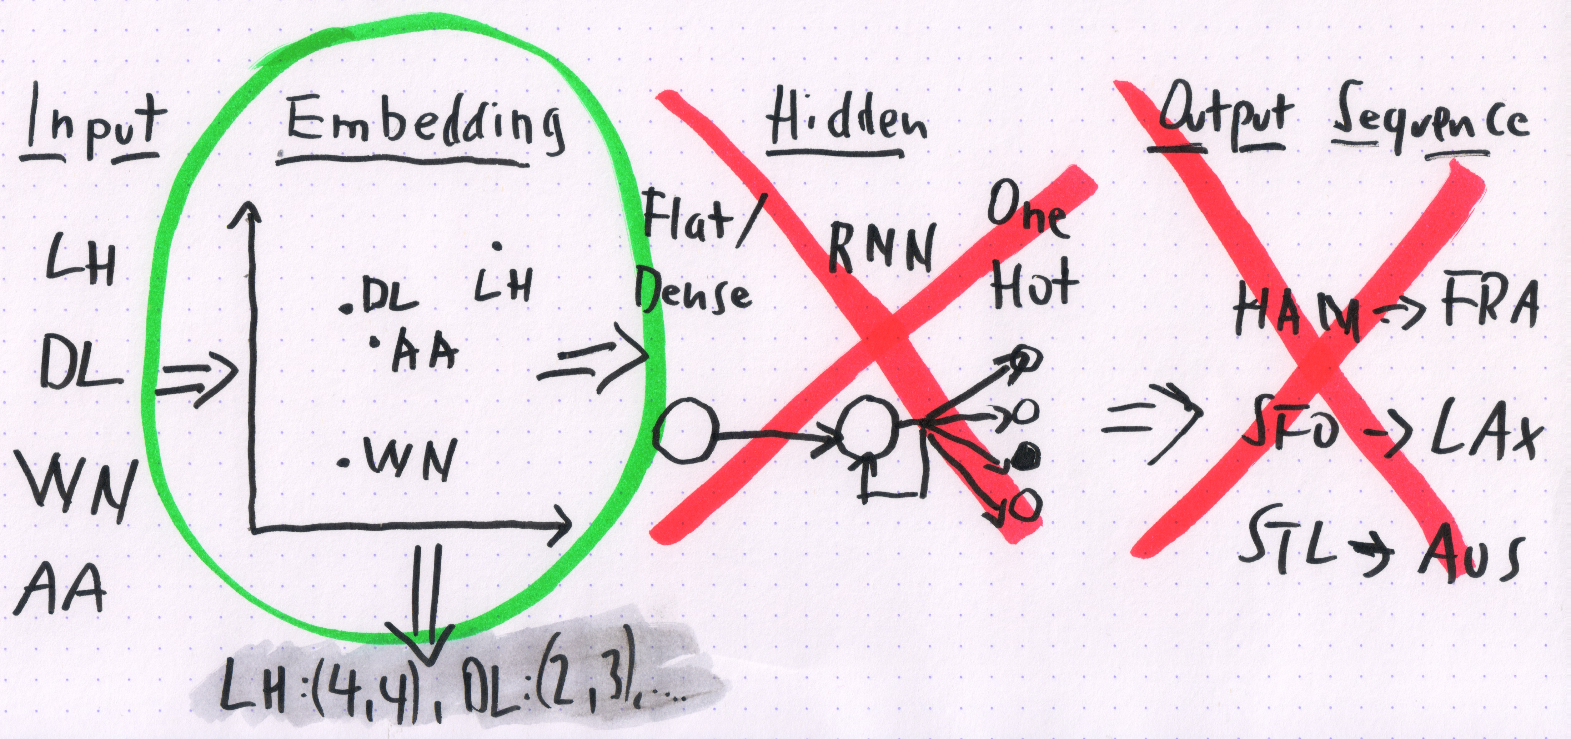


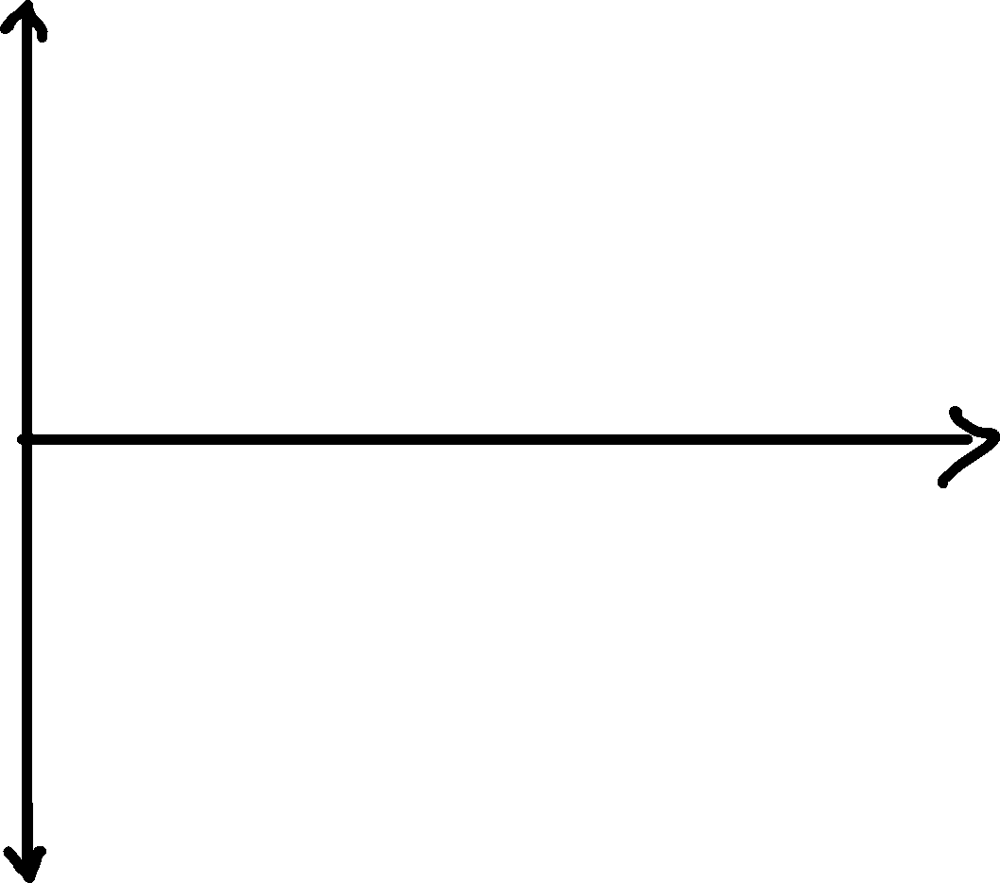





Understanding Neural Embeddings Oliver Zeigermann @DJCordhose
Understanding Semantic Embeddings
Basic question: How to turn categories into a small amount of numbers?
neural networks can not deal with symbols
only numerical values can be processed
make those numbers carry the semantics of the words or symbols
Examples:
Grade
IQ
Humans are good at this: Locate your favorite airline below
Sample Application: Airlines
Use Case 1: n-dim Embedding as input layer for further processing
Use Case 2: 1-d Embedding vs Passengers as a plot / cluster for data visualization
How to Embed
Basic Idea: Train a model and squeeze input through a bottle-neck. Use that bottle-neck as the semantic representation during prediction.
What do you want to embed? Airlines
What data do you want to use to express similarity? Typical Routes flown by Airline
Prepare data accordingly
Set up network and choose loss function
Train with small batch size and make sure model trains (loss goes down)
Predict categories and use Embedding layer (the bottle-neck) as new output
Link to notebook: http://bit.ly/embed-airlines

